Slide 1
Reasons Why you should Date me!

Slide 2
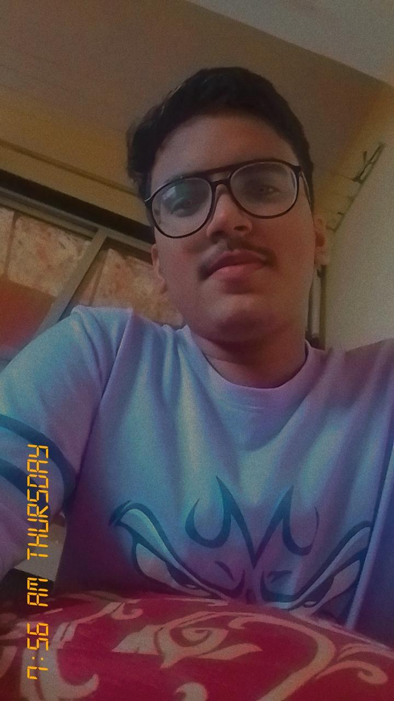

I am cute!!
That’s true here are the examples:

Slide 3
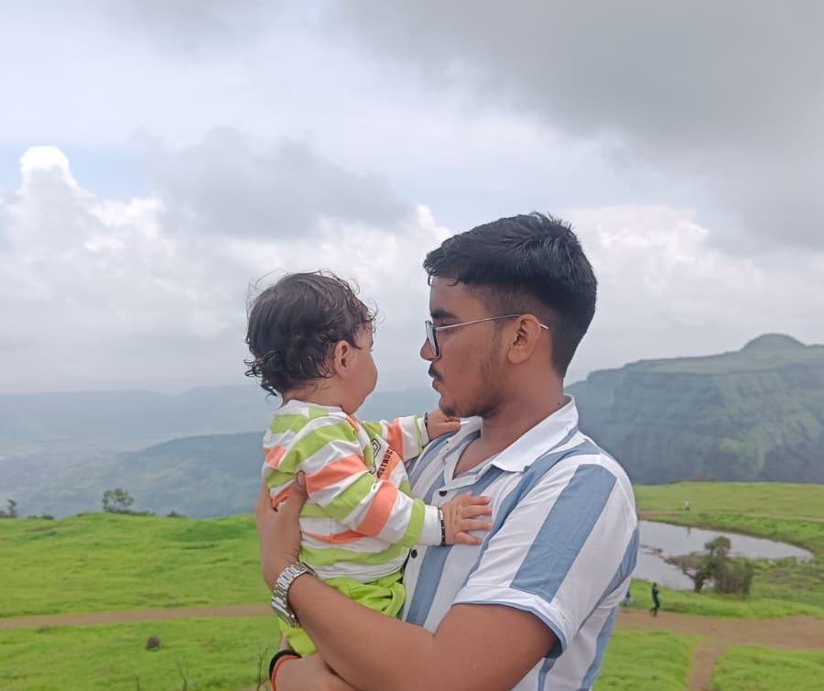
I am Good with kids
Since I am good with kids I know how to care.
(Tum bhi bachi ho na)

Slide 4
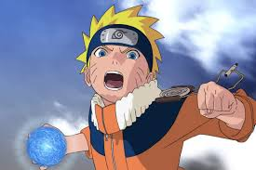
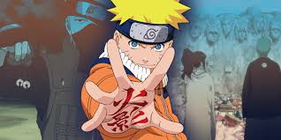
I have completed Naruto
So we can also watch that together

Slide 5
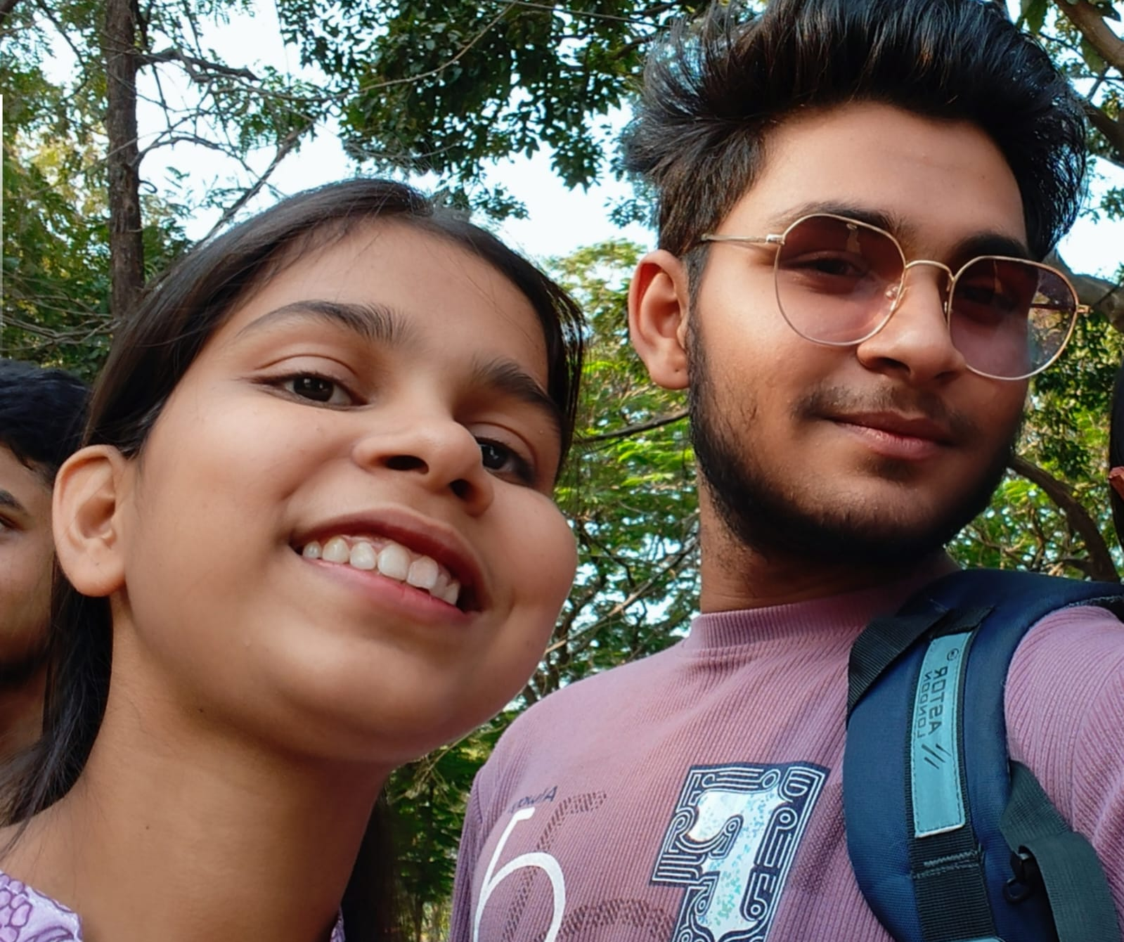
I don't mind you going out with others
I am not toxic!!

Slide 6
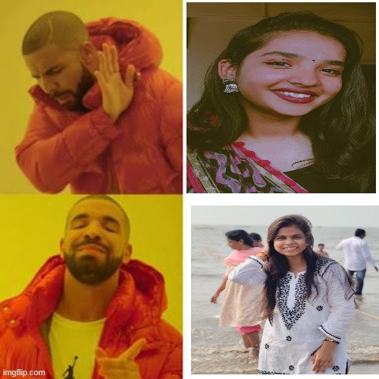
I will always choose you
Whatever the choice

Slide 7
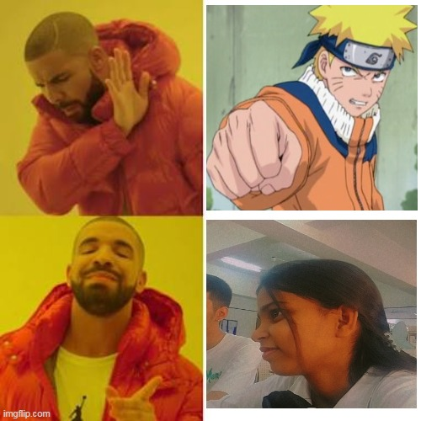
Whatever the Choice

Slide 8
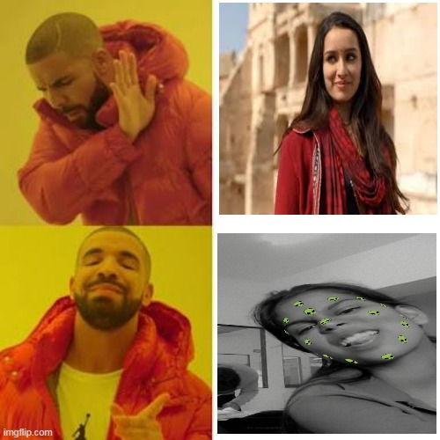
Whatever the choice
This was very hard

Slide 9
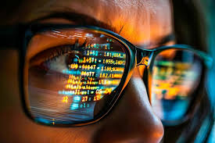
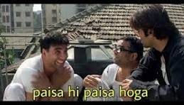
CS wala hu mai
5 Saal baad paisa he paisa hoga

Slide 10
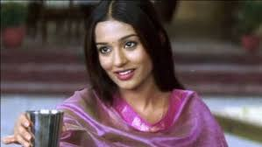
Abhi bhaut baki hai toh →
Paani pe lo

Slide 11
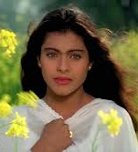
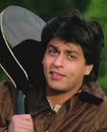
Bollywood Reference bhi jaruri hai
If you are:
I will be:

Slide 12
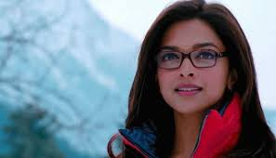
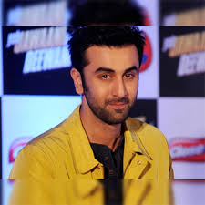
If you are:
I will be:

Slide 13
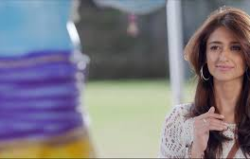
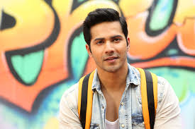
If you are:
I will be:

Slide 14
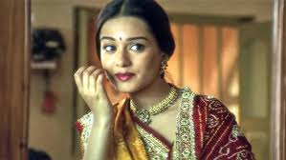
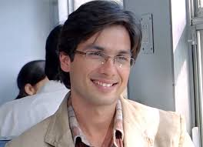
If you are:
I will be:

Slide 15
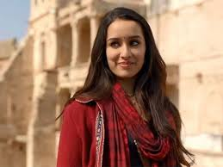
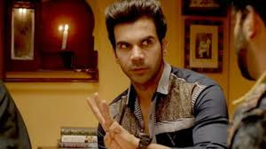
If you are:
I will be:

Slide 16
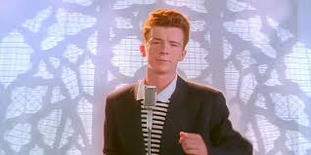
Whatever the situation is but……
Never Gonna give you up

Slide 17
And now
What Dating me is like

Slide 18
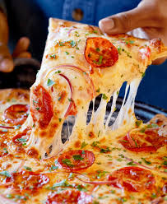
Dating me is like
Eating pizza → sometimes cheesy, but always satisfying!

Slide 19

Dating me is like
Coffee → addictive, energizing, and you'll keep coming back for more.

Slide 20
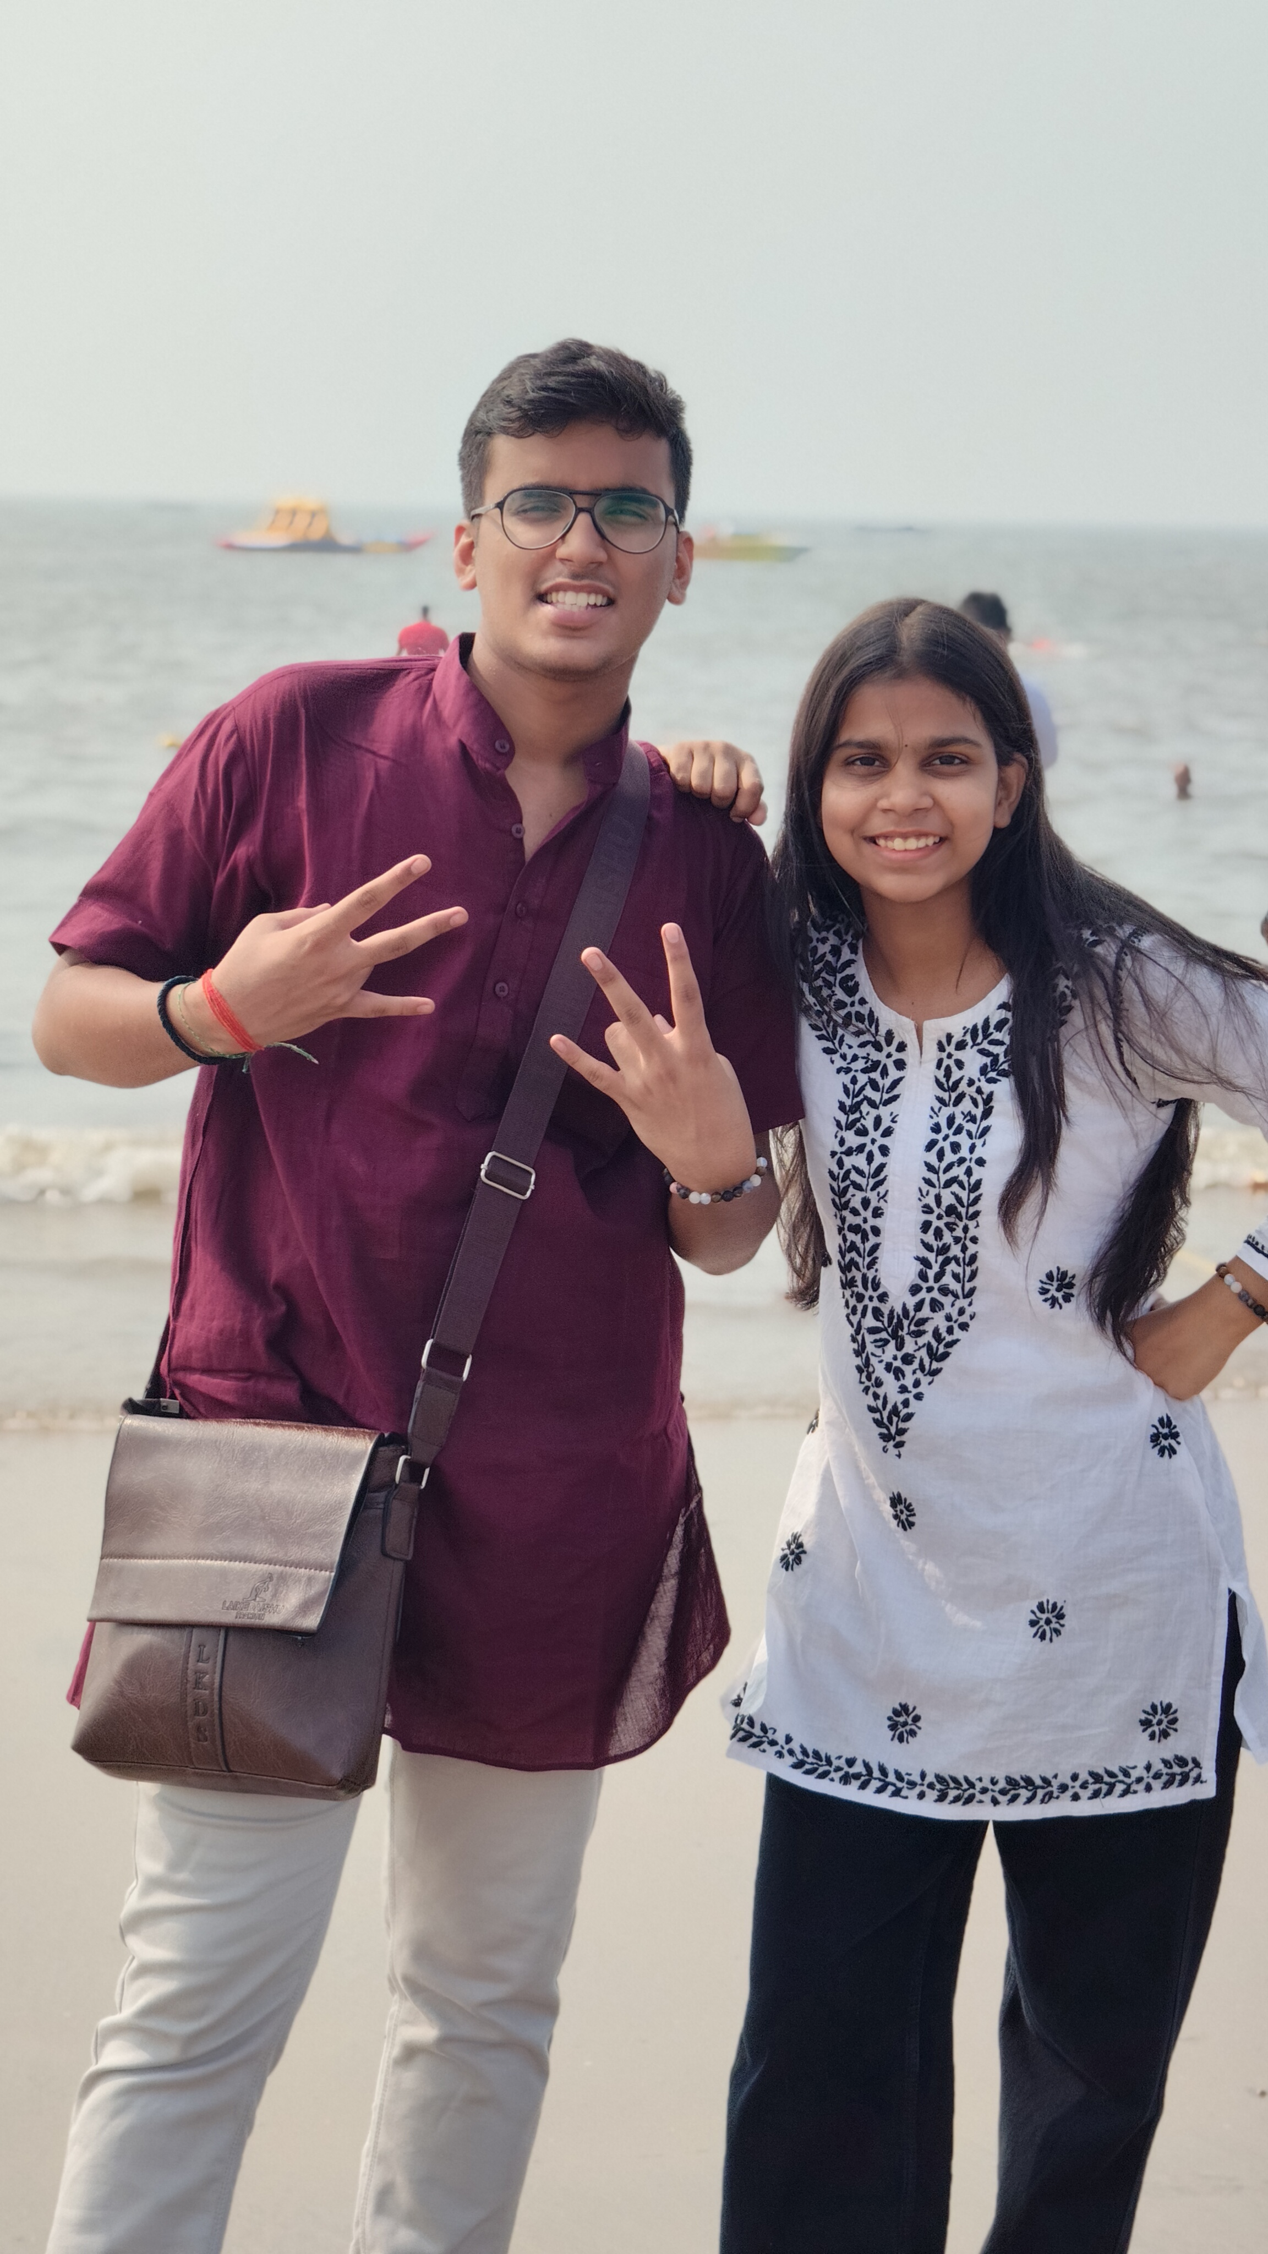
Dating me is like
Group Project → Galti Dono ki Daat ek he khayega.
(Mai)

Slide 21
Dating me is like
Rutuja → Rehnedo Dark ho jayeaga

